Slide 1
BLOCKCHAIN BASED CERTIFICATE VALIDATION
Team Members
Pon Anitha C
Pooja Sree V
Poorvaja S
Guide
Dr. S.Baghavathi Priya
Professor/IT

Slide 2
Objectives
To develop a certificate validation system that aims to store the certificates in their hash format.
To make sure the certificate data is accessible at all times and doesn’t vanish due to some server failure.
To ensure the safety of the certificates, SHA-256 algorithm is implemented through blockchain technology.
To ensure that no malicious users use the system, a two-step verification is deployed.

Slide 3
Introduction
The certificate verification process is an ever occurring and tedious process.
Producing the original certificates each and every time for verification and then placing it back into safety is a tough process.
Also, no harm or damage must befall the certificate during the process of verification.
It is known that certificates literally define our lives. Once lost or damaged, it takes a long time to obtain another original certificate.
90% of the institutions in India, be it universities or schools, hold the student’s certificates until the student leaves that institution.
Companies that recruit employees, double check the student’s mark by demanding their certificates.

Slide 4
Introduction
Instead of producing the certificates each and every time, or leave the certificates with any institution, a system is proposed where the certificates can be stored in a hashed format and ensured safety.
The system proposed is a website, where the certificates can be stored as hashes and retrieved as and when required, and verified.
The system is available for two kinds of users, the students and any valid organizations who wish to go through the student’s certificates.
The system uses the latest technology, blockchain, which stores each hash of the certificate in each block, in a private network, open to the students and organizations only.

Slide 5
Literature Survey
S.No | Title | Authors | Methodology | Challenges
1. | The Future of Data Storage: A Case Study with the Saudi Company (2018) | Azzah Al Ghamdi, Thomas Thomson | Investigates the data storage methods and future requirements for one of the largest oil companies in the world, Saudi SA Oil Company. | Data is stored in a centralized storage, backup data has lot of constraints, security is provided through checksum.
2. | United States Patent Borlick et al Date of Patent : Jan . 1 , 2019 Patent No . : US 10 , 171 , 585 B2 | Matthew G . Borlick Lokesh M . Gupta Roger G . Hathorn Karl A . Nielsen | A system which stores different parts of data in various clouds. | It is unknown at what place the data is stored, if any attacks are made on the data and the data is stored only for a particular time period.
3. | A Survey on the Security of Blockchain Systems[2018]. | Xiaoqi Li Peng Jiang Ting Chen Xiapu Luo Qiaoyan Wen | A systematic study on the security threats to blockchain and survey the corresponding real attacks by examining popular blockchain systems is done. | Consensus mechanism PoW is a waste of computing resources and not all of the data stored in blockchain is valid.

Slide 6
Literature Survey
S.No | Title | Authors | Methodology | Challenges
4. | Digital Signature Certificate Policy for Railway Units (2017). | Government of India Ministry of Railways | Approval of digital signature certificates for all Railway units.
5. | Long-term preservation of big data: prospects of current storage technologies in digital libraries(2017) | Wasim Ahmad Bhat | Investigate the prospects of current storage technologies for long-term preservation of big data in digital libraries. | Current storage technologies might not fulfil the long term storage of library data in the future.
6. | Document Validation and Verification System.(2016) | Samit Shivadekar Stephen Raj Abraham Sheikh Khalid | 'E-Governance system' will be an online platform for deliverance of Government to Citizen Services and storage of digital certificates, documents etc. | There is the high initial cost of implementing such a system, as is typical of all computerized systems.

Slide 7
Literature Survey
S.No | Title | Authors | Methodology | Challenges
7. | Designing An Automatic Web-Based Certificate Verification System For Institutions.(2015) | Nwachukwu-Nwokeafor K.C Igbajar Abraham | Design an online certificate verification system based on the verification process adopted by the university to verify the results. | There is the high initial cost of implementing such a system, user knowledge on using the system.
8. | An Academic Certification Verification System Based On Cloud Computing Environment (2015). | Nicholas Mwankiki Musee. | Developed prototype which is used as SaaS to provide certificate verification. | The central server failure will put the whole system in jeopardy.
9. | Verification of the integrity and legitimacy of academic credential documents in an international setting (2008). | George D. Gollin | Public-key cryptography provides a technical solution to the problem of authenticating academic documents such as transcripts and diplomas. | Electronic Transcript Technology has not yet developed to a higher level.

Slide 8
Proposed System
The certificate validation system provides an online website to upload and retrieve the hashes of the certificates.
Each certificate is uploaded in its hash format and is stored using blockchain.
The hashes are stored in unique transactions in nodes, which are deployed on a private network.
Each node maintains a copy of the transactions along with the hashes, thus making it available at any time.
The certificates are hashed using the SHA-256 algorithm, and also, the transaction ids are obtained using the same.

Slide 9
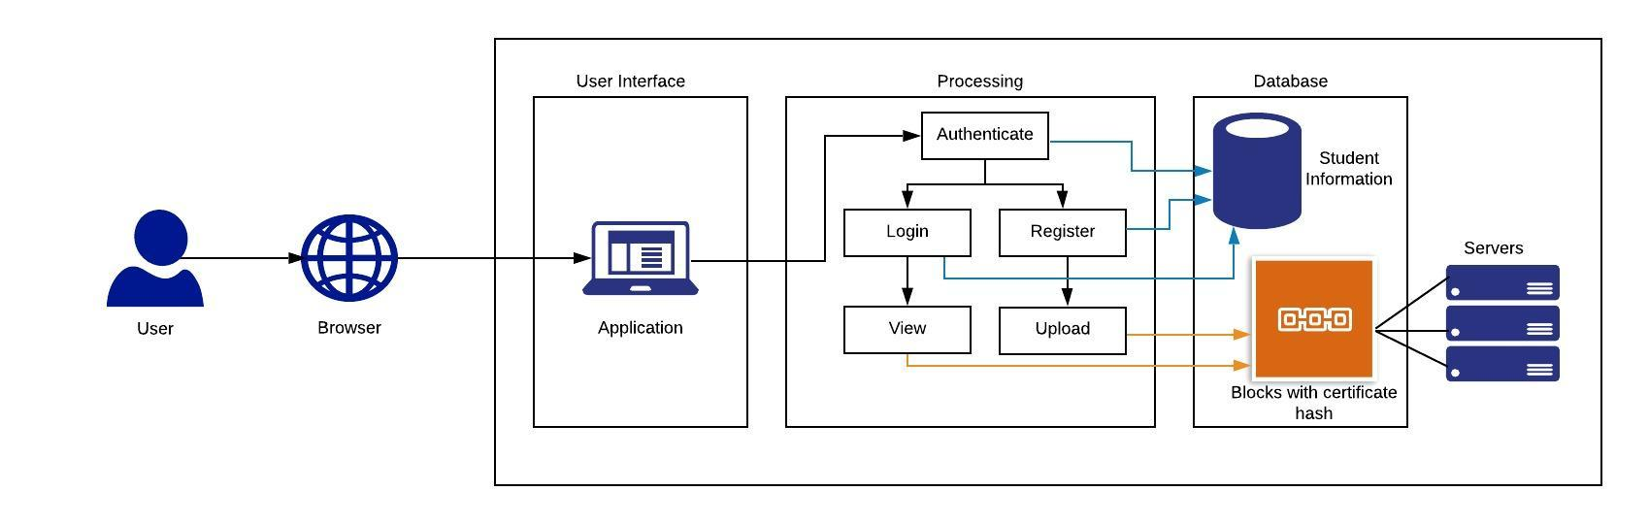
Architecture Diagram

Slide 10
Student Module
The student uses the web application that is integrated with blockchain to store and retrieve the hash of the certificates. Steps to be followed in this module are:
Step i) The user needs to enter their 10th grade register number into the UI to enter into the system.
Step ii) The user is then led to a register/ login page, where they can choose either option.
Step iii) The user needs to register before using the system if they are a new user, or login directly, if they are an existing user.
Step iv) On the next page, the user maybe able to the operations of either uploading the certificate hash or viewing the certificate hash.

Slide 11
Organization Module
The organization uses the web application to view the hashes of the certificates that the students have uploaded so that they can verify if the certificates in hand are authentic. Steps to be followed in this module are:
Step i) The user should enter the organization code to enter into the system.
Step ii) After submission of the credentials, the user is directed to a page where student’s user name is required to view the student details.
Step iii) Upon entering the student’s username, the organization will be able to verify whether the student certificate with the organization is authentic or not.
Step iv) The user will be displayed with the student’s username, and the hash of the certificate that the student has uploaded.

Slide 12
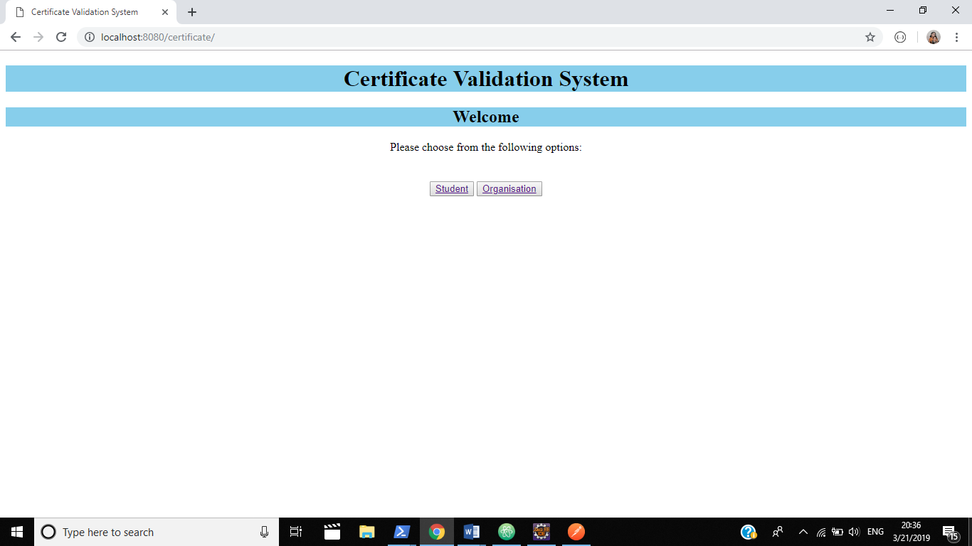
Screenshots

Slide 13
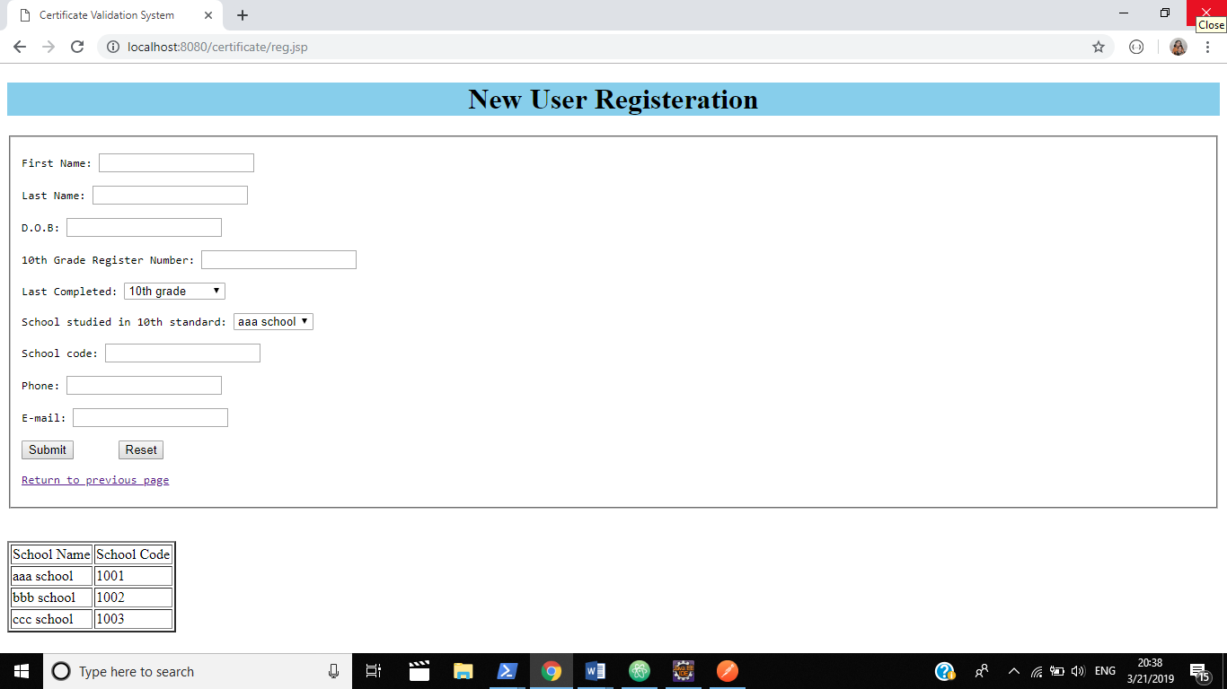

Slide 14
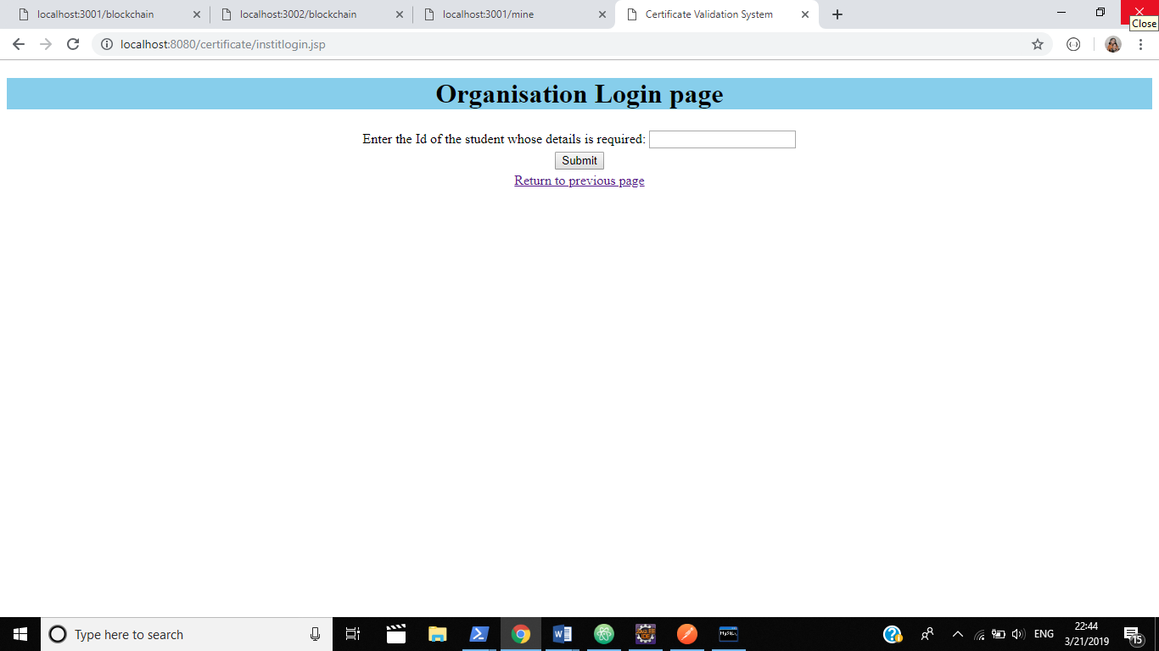

Slide 15
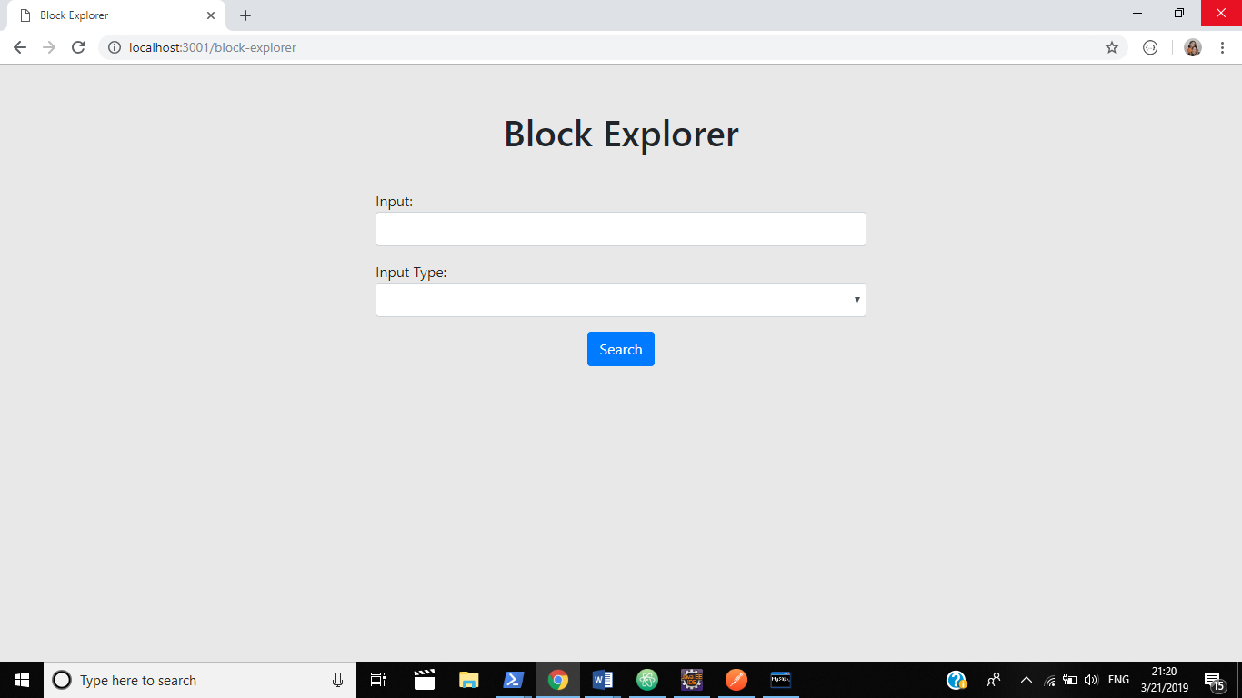

Slide 16
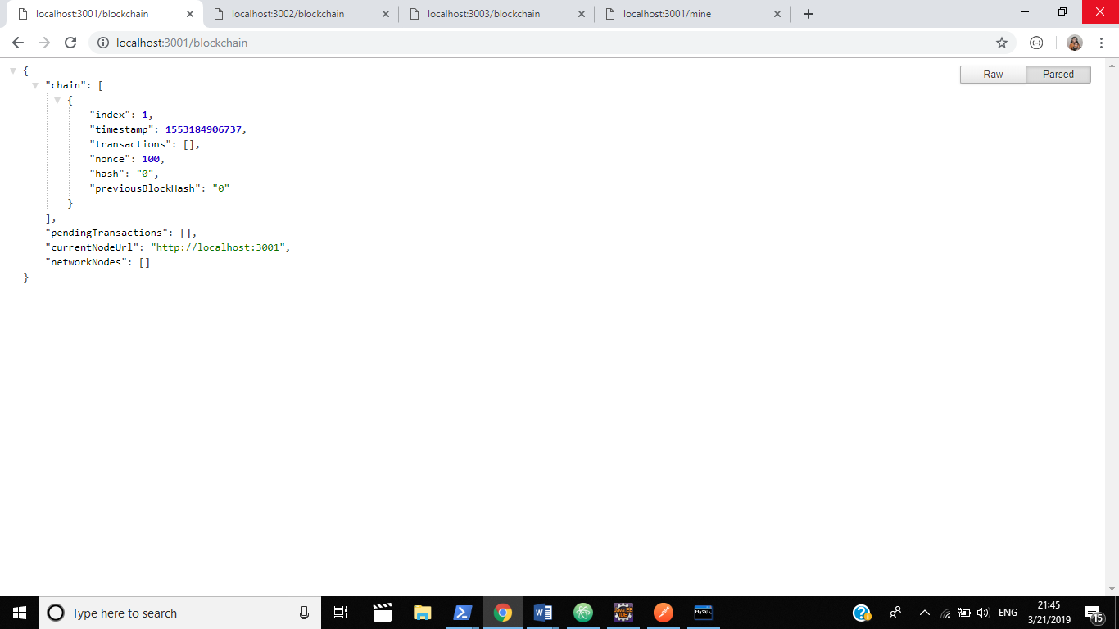

Slide 17
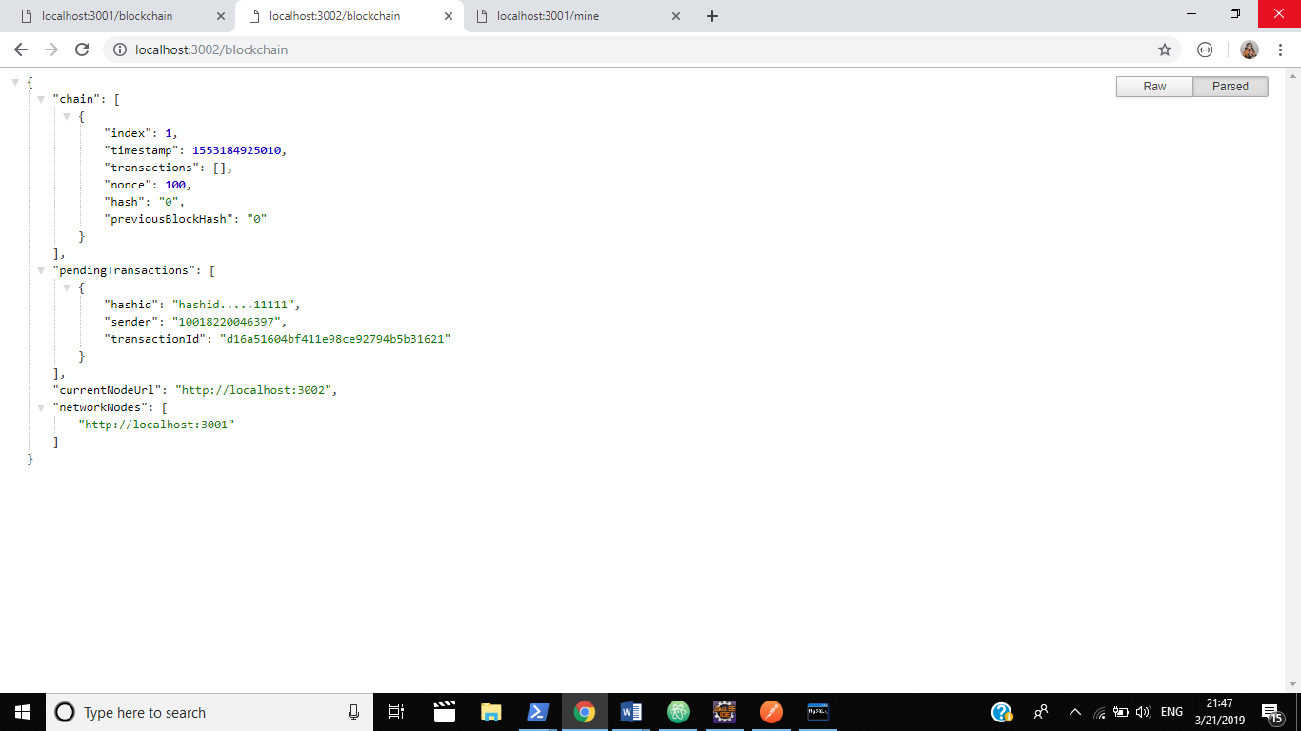

Slide 18
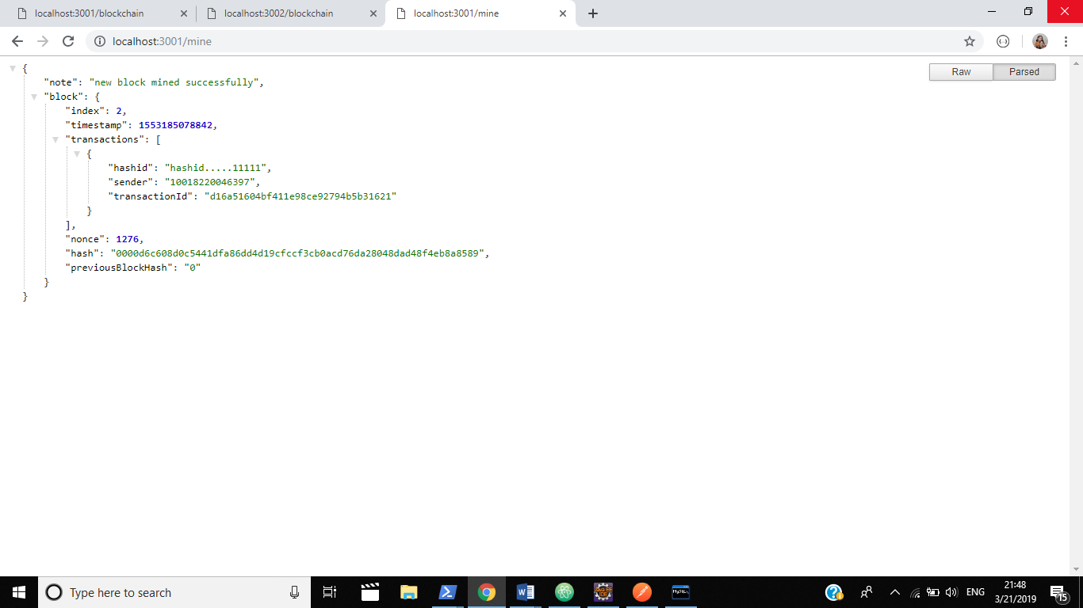
Results

Slide 19
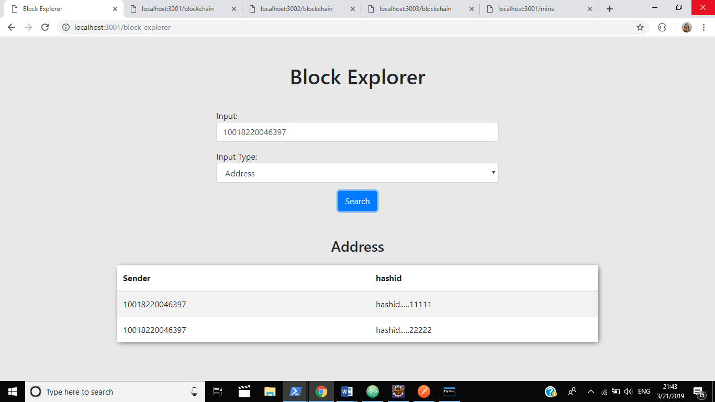

Slide 20
Conclusion
We have developed a web application for the Certificate Validation system using Blockchain. The system helps the user in verifying a certificates authenticity by comparing it with the uploaded hash. Also, the system provides the provision of uploading the certificates hash. The experiments conducted for the sample data set with the proposed method produced good and the expected results.

Slide 21
Future Enhancements
Uploading of the certificates directly along with their hashes.
Improvement in the retrieval of data from the blocks.
Use of different consensus algorithms.

Slide 22
References
Azzah Al Ghamdi and Thomas Thomson,“The Future of Data Storage: A Case Study with the Saudi Company”, published in Journal of Electrical and Electronic Engineering in 2018.
Borlick et al. ,United States Patent “Patent No.: US 10, 171, 585 B2” Date of Patent: Jan. 1, 2019.
Xiaoqi Lia, Peng Jiang, Ting Chen, Xiapu Luo, Qiaoyan Wen,“A Survey on the Security of Blockchain Systems”, in arXiv:1802.06993v1 [cs.CR] 20 Feb 2018.
Government of India, Ministry of Railways, Railway Board has passed the “Digital Signature Certificate”- No. 2017.RBCC/7/10/e-Office/DSC Policy for IR, Policy on 21.07.2017.
Wasim Ahmad Bhat, (2018) "Long-term preservation of big data: prospects of current storage technologies in digital libraries", Library Hi Tech, Vol. 36 Issue: 3, pp.539-555, https://doi.org/10.1108/ LHT-06-2017-0117.
Samit Shivadekar, Stephen Raj Abraham, Sheikh Khalid,“Document Validation and Verification System” in International Journal of Advanced Research in Computer Engineering & Technology (IJARCET) Volume 5 Issue 3, March 2016 .
Nwachukwu-Nwokeafor K.C and Igbajar Abraham,“Designing An Automatic Web-Based Certificate Verification System For Institutions” by in Journal of Multidisciplinary Engineering Science and Technology (JMEST) ISSN: 3159-0040 Vol. 2 Issue 12, December – 2015 www.jmest.org JMESTN42351206 3393
Nicholas Mwankiki Musee“An Academic Certification Verification System Based on Cloud Computing Environment” in University of Nairobi. P58/63483/2011.
George D. Gollin “Verification of the integrity and legitimacy of academic credential documents in an international setting”, available in the site http://www.hep.uiuc.edu/home/g-gollin/CUJ8404AR_Gollin.pdf .

Slide 23
Thank You

